Slide 1


North western university
Introduction to Computer Network Using NS2 based on the domain as www.telegram.com
Course Title: Computer Networks Sessional
COURSE CODE: CSE-3304
SP CSE-3304

Slide 2




Team Name: NWU_TL
This is our team Members
Name: Armin Jahan Neha
ID: 20201137010
Department of CSE
North Western University
Name: Najnine Afroz Estina
ID: 20201144010
Department of CSE
North Western University
Name: Rifa Tamanna
ID: 20201145010
Department of CSE
North Western University
SP CSE-3304

Slide 3

Overview
Computer Network
Why computer network is used?
Bird’s eye view of the project
Introduction to Zenmap
Different Host to Domain: Telegram
Design network topology
Prepare excel sheet for network diagram
Introduction to NS2
Output topology of NS2
Summarization of the designed network
Conclusion
References
SP CSE-3304

Slide 4

What is computer network?
A computer network is a set of computers sharing resources located on or provided by network node.
The computers use common communication protocol over digital interconnections to communicate with each other.
These interconnections are made up of telecommunication network technologies, based on physically wired, optical, and wireless radio-frequency methods that may be arranged in a variety of network topologies.
SP CSE-3304

Slide 5

Why computer network is used?
The use of computer networks can overcome geographic barriers and enable the sharing of information.
Computer networks enable the usage and sharing of any number of applications and services, including emails, video, audio and plenty of other types of data, over the internet.
SP CSE-3304

Slide 6

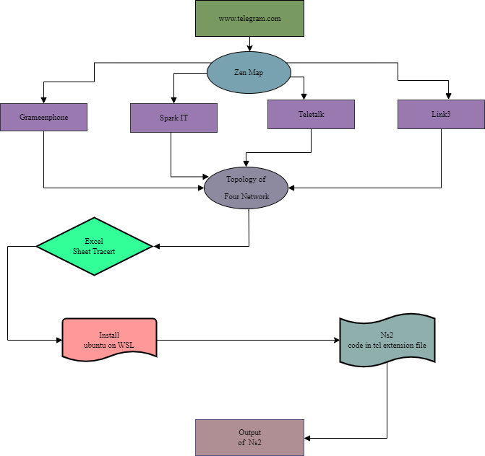
Fig: Bird’s eye view of the project
SP CSE-3304

Slide 7
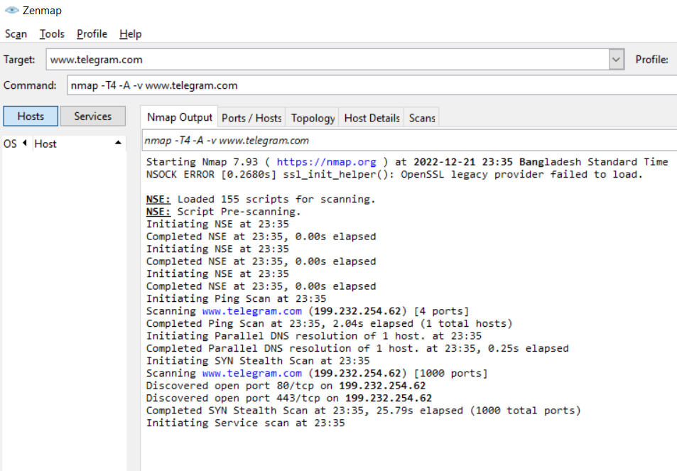
Introduction to Zenmap
Zenmap is the official graphical user interface (GUI) for the Nmap Security Scanner. It is a multiplatform, free and open-source application designed to make Nmap easy for beginners to use while providing advanced features for experienced Nmap users.
SP CSE-3304

